Slide 1
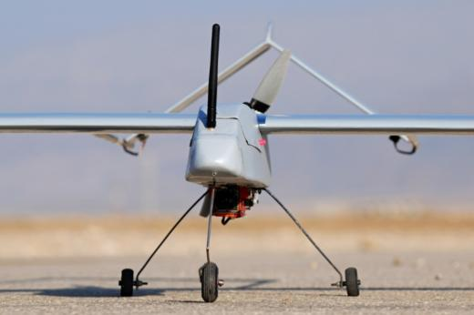
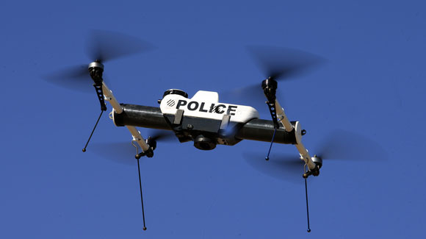
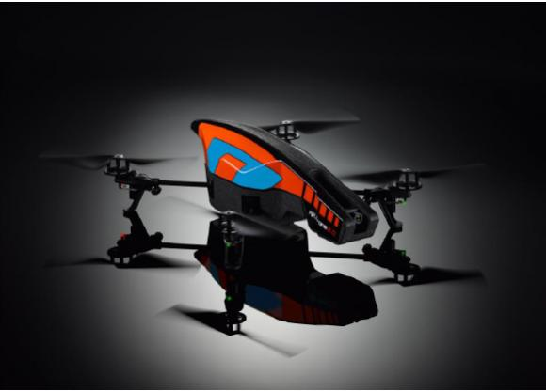
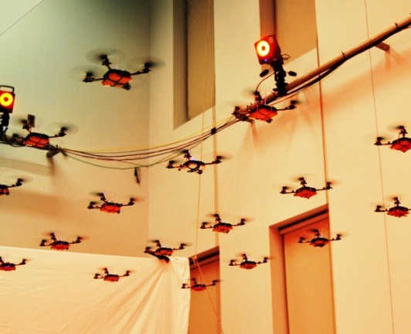
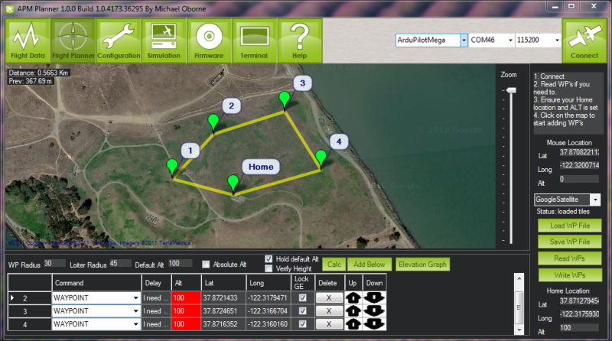
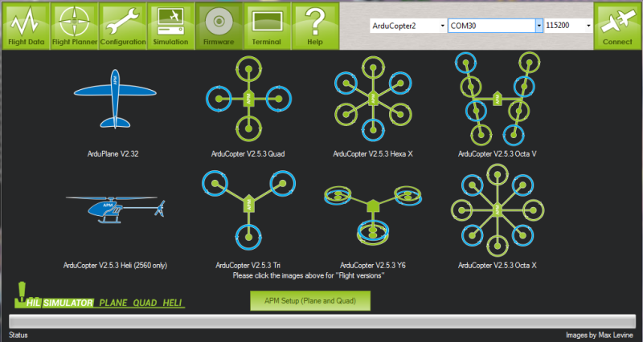
Arial Robotics
Revive the origins of RHRT
Get students involved in the growing field of areal robotics
Compete in robotics competitions\
Have fun and peruse aerial and robotic hobbies
Links:
code.google.com/p/arducopter
diydrones.com
iarc.angel-strike.com

